Slide 1
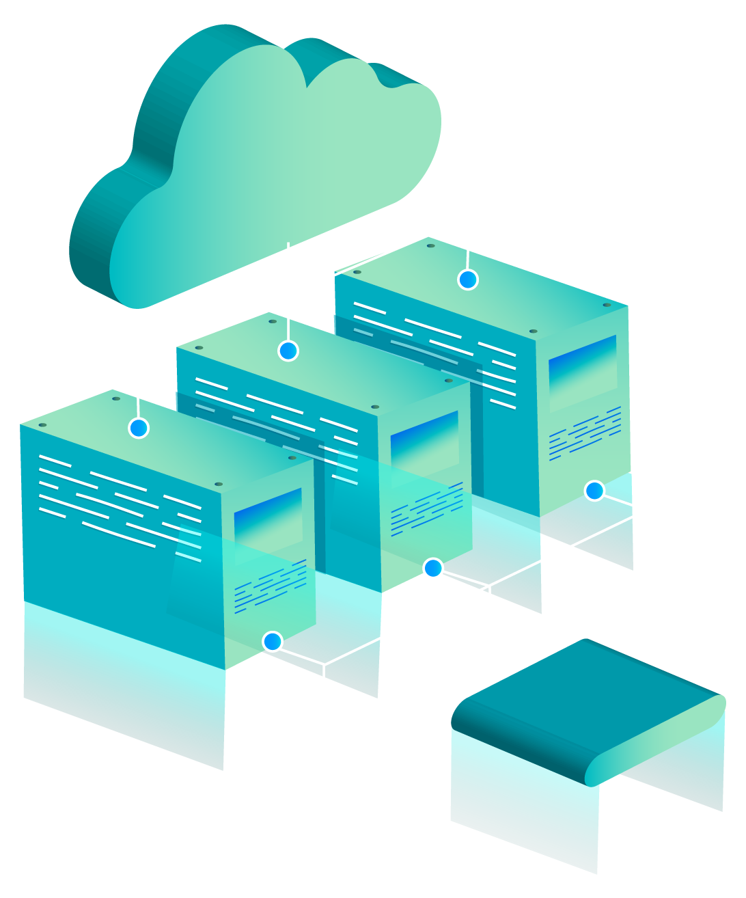
CLOUD City
Population: Alex Kelley, Noah Stiles, and Tanner Weinacker,

Slide 2
Background & History
AWS History
My History
In 2003 Amazon had figured out they held a key advantage over their competitors. This advantage was their ability to manage and scale infrastructure reliably and effectively. This is how AWS was born. Within three years Amazon turned this idea into reality. In 2006 Amazon Simple Queue Service was launched which was then followed by S3, and EC2.
I took my first cloud computing class in September 2022. I fell in love with it, and thought there is a lot of potential in the industry. I wanted to familiarize myself with as many services as possible. While doing that Professor Goldstein asked if I would be interested in this capstone and I thought it would be a great opportunity. I then began studying all services and getting acquainted with as much of AWS as possible.

Slide 3
Research Phase

Slide 4
The Fundamentals
Services
Documentation
AD Concepts
Services offered by AWS and their use within the network
The key to any good project is the documentation.
Prices, connectivity, and applying policies systematically.
Github
Notion

Slide 5
Production Phase

Slide 6
Manual
To first learn the automation of AWS, I first needed to learn how to manually do the work. Within this point I created OUs, Policies, IAM users, Full AWS accounts, AD connections, VPCs and much more.
Every step of the way I had to properly document everything. This allowed me to return and review how to efficiently automate this process.
Documentation

Slide 7
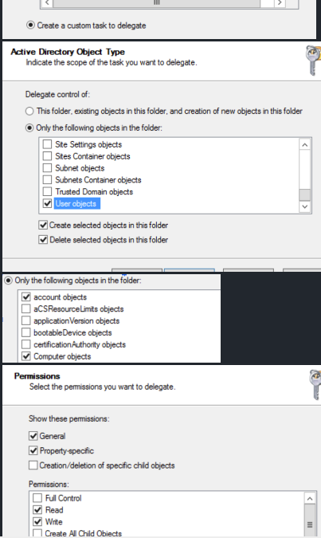
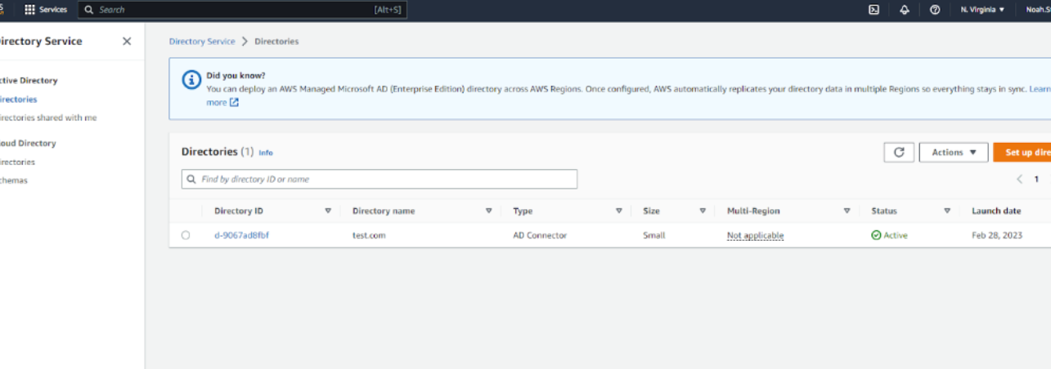
This is the least perms possible for AD connection
Here is the initial connection to the AD

Slide 8
Automation
User Creation
OU Creation
Ad Connector
This script, creates IAM users within a specified group. It also attaches a policy created within the script
View Script
This script, creates OUs, it has a nested option.
View Script
This script, connects an on premise AD to the cloud. It needs a service account but through Cloud Formation this is possible.
View Script

Slide 9
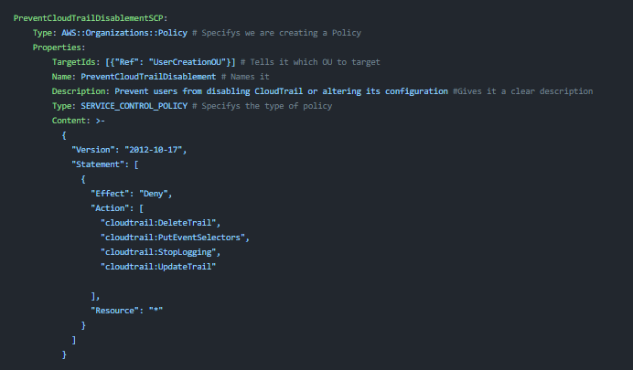
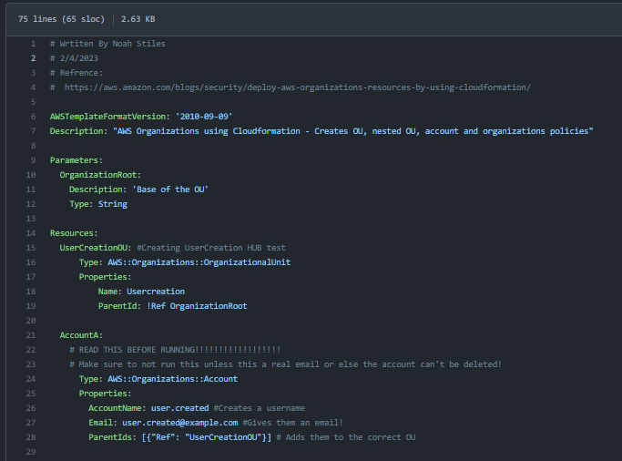
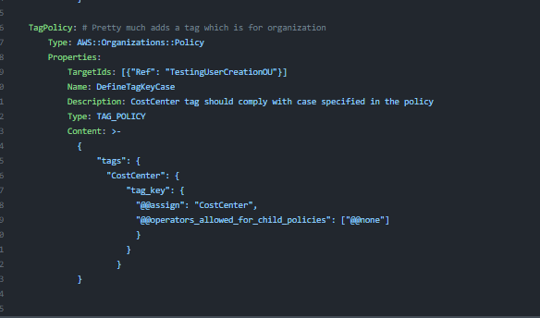
Altogether
This script combines OU Creation, account creation, and policy making.

Slide 10
Conclusion Phase

Slide 11
Overall
Although the project isn’t going into production. We have set the basis for a AWS team in the future. Our research and development will be passed down to future students to build a cyber.local cloud hybrid.
Currently we have a test environment with iam users, an Ad connection, and other features.

Slide 12
Problems encountered and resolutions

Slide 13
Separation of users
Problem:
Users were all able to see each other and this was the main part of our project
Solutions:
We were able to deploy an SCP to negate this
Further, we found separating users based on region works
As well as through policies

Slide 14
AD Least Level Perms allowed
AD Connector…Least level perms possible due to the fact it will be on essential equipment
Was able to achieve this through trial and error and research.

Slide 15
My takeaway
Like in life you get the most out of what you put into it. I put countless hours into this project, and although it will not be going into production, I am happy with what I have achieved and learned. Some skills that I take away from this are not just cloud services, and mechanics but how to work on a team, research skills, documentation and so much more.
Noah Stiles

Slide 16
Thank you!
With a special thanks to Joe, Adam, Devin, Duane, Ginter, Jason, & all other professors that helped me along the way.

Slide 17
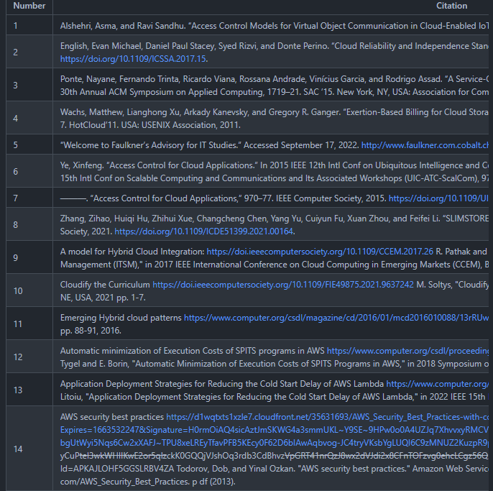
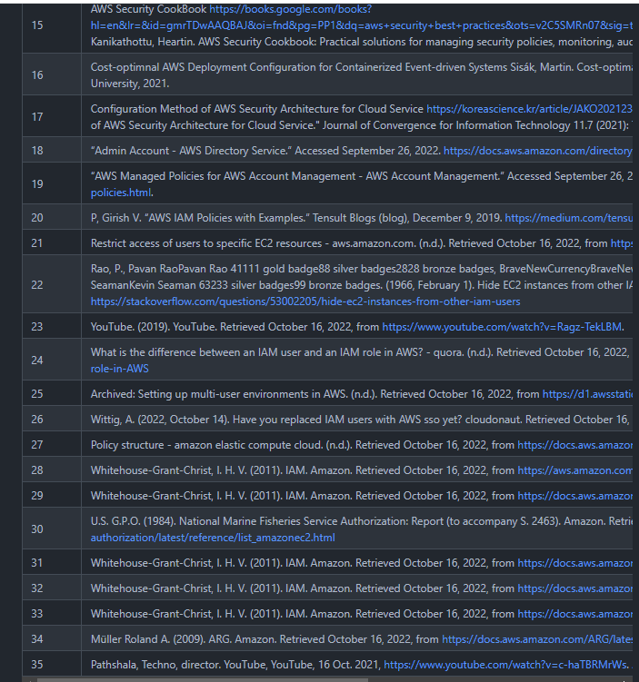
References
Link to Wiki

